Slide 1

Integrated didactics:
German after English

Slide 2
Four pluralistic approaches
Integrated didactic approach to languages
Intercomprehension between related languages
Awakening to languages
The intercultural approach

Slide 3
Pluralistic approaches to languages and cultures
Four pluralistic approaches
Integrated didactic approach
It is directed towards helping learners establish links between all languages studied within the school curriculum (including the language(s) of instruction).
It makes it possible to implement a general principle underlying every learning process: relying on what is known to deal with what is less known - on the language of schooling to tackle the first foreign language, on these both languages to find a way into the second foreign language, and so on... not forgetting the feedback effects of such synergies.
3
Notes:
3

Slide 4
Anna Maria Curci (2008),
After English, German.
Affinities between German and English
common sounds
common vocabulary: 600 words (Hufeisen, 1993)
possessive adjectives: his son = sein Sohn, her son = ihr Sohn
comparatives, superlatives: long, longer, the longest = lang, länger, am längsten
strong verbs: sing, sang, sung = singen, sang, gesungen
word formation principles: suffixes as helpless = hilflos and compound words as school book = Schulbuch
…
Notes:
http://muttercourage.files.wordpress.com/2008/03/after_english_german.pdf

Slide 5
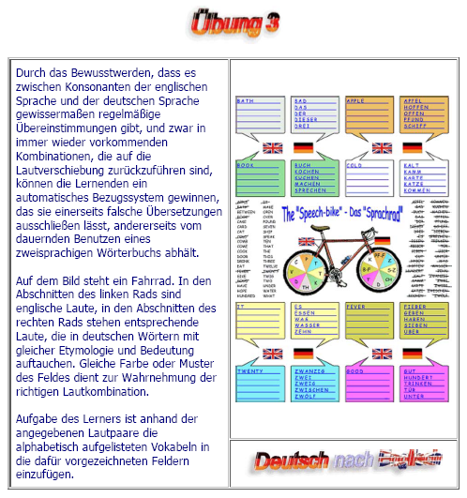
An example: From Übungsvorschläge für „Deutsch nach Englisch“ – M. C. Berger & A. Colucci.
http://ospitiweb.indire.it/ictavagnacco/deutsch/deutsch_nach_englisch/Ex_3.htm
Making students aware of the existing regular correspondence between consonants in German and in English.
The consonants in English are represented in the left wheel, those in German in the right one.
The task for the student is to find among a list of English words the word corresponding to each German item.
5

Slide 6
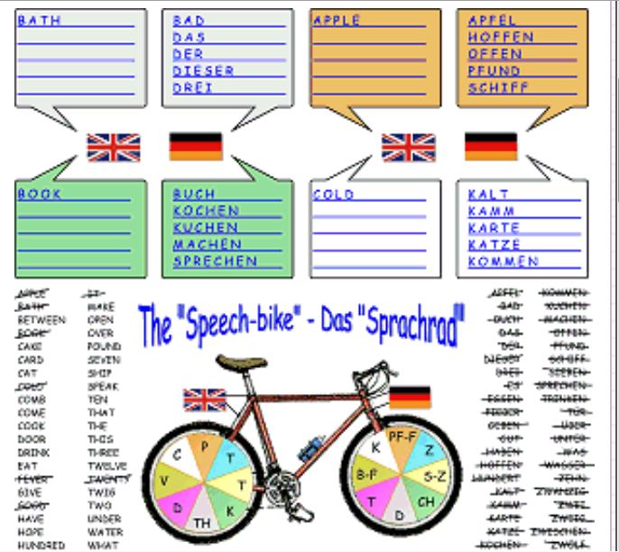
CAKE
CAKE
HAVE
?
CARD
HOPE
(German after English)
CAT
HUNDRED
COMB
MAKE
COME
OPEN
COOK
OVER
DOOR
POUND
DRINK
SEVEN
EAT
SHIP
GIVE
SPEAK
…
6

Slide 7
CAKE
HOPE
CAKE
HAVE
OPEN
POUND
CARD
HOPE
SHIP
(German after English)
CAT
HUNDRED
COMB
MAKE
COME
OPEN
COOK
OVER
DOOR
POUND
DRINK
SEVEN
EAT
SHIP
GIVE
SPEAK
…
7

Slide 8
CAKE
HOPE
CAKE
HAVE
OPEN
POUND
CARD
HOPE
SHIP
(German after English)
CAT
HUNDRED
COMB
MAKE
COME
OPEN
?
COOK
OVER
DOOR
POUND
DRINK
SEVEN
EAT
SHIP
GIVE
SPEAK
…
8

Slide 9
CAKE
HOPE
CAKE
HAVE
OPEN
POUND
CARD
HOPE
SHIP
(German after English)
CAT
HUNDRED
COMB
MAKE
COOK
COME
OPEN
CAKE
MAKE
SPEAK
COOK
OVER
DOOR
POUND
DRINK
SEVEN
EAT
SHIP
GIVE
SPEAK
…
9

Slide 10
Integrated didactic approach
Example taken from:
Kursiša, A. & Neuner, G. (2006). Deutsch ist easy – Methodische Grundlagen für Deutsch nach Englisch. Ismaning: Hueber.
It is thought for students having already learnt some English and starting with learning German.
Which knowledge,
attitudes, skills can
be developed by
this activity?
10

Slide 11
11

Slide 12
12

Slide 13
Integrated didactic approach
Example taken from:
Kursiša, A. & Neuner, G. (2006). Deutsch ist easy – Methodische Grundlagen für Deutsch nach Englisch. Ismaning: Hueber.
This material helps students to discover lexical similarities and grammatical differences between both languages, as well as with their own mother tongue (and / or language of education) …
It is thought for students having already learnt some English and starting with learning German.
13

Slide 14
Possible results
Skills
S 3.4.1 Can perceive direct lexical proximity
S 3.7 Can compare the grammatical functioning of different languages
S 5.3.3 Can establish grammatical regularities in an unfamiliar language on the basis of grammatical regularities in a familiar language / can carry out transfers at grammatical level
S 7.3.2 Can use knowledge and skills acquired in one language to learn another
S 1.1.3 Can resort to a known °language / culture° with a view to developing an analysis of another °language / culture°

Slide 15
Possible results
Knowledge
K 6.6 Knows that there is no word for word equivalence from one language to another
K 6.7 Knows that words may be constructed differently in different languages
K 7.2 Knows that one can build on the (structural / discursive / pragmatic) similarities between languages in order to learn languages
Attitudes
A 15.2 Considering every °language / culture° as “something” accessible (some aspects of which are already known)
A 17.4 Having confidence °in one’s own abilities in language learning / in one’s abilities to extend one’s own linguistic competences°
A 18.1 A positive attitude towards the learning of languages (and the speakers who speak them)

Slide 16
Integrated Didactics and the Lithuanian Curriculum – Discussion :
For whom?
When?
How?
…
…
…

